Slide 1
Zman Telecon
29 Oct 2009
BDML

Slide 2
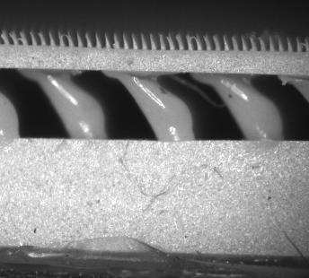
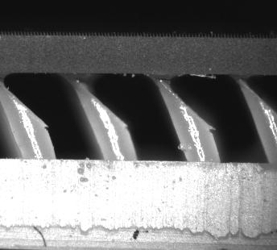
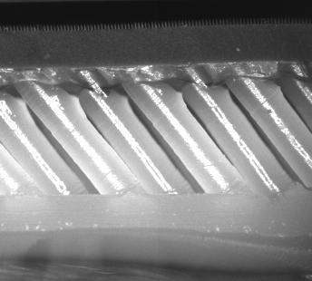
Microscope Pictures In situ
Hier I
Hier II
Hier III

Slide 3
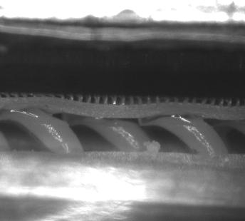
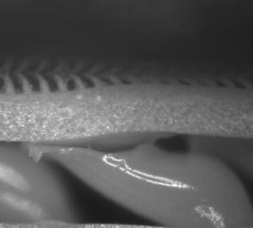
Hier I

Slide 4
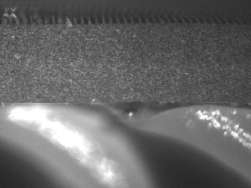
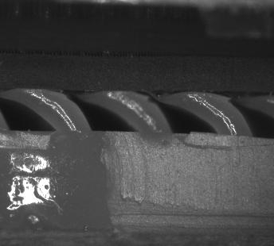
Hier II

Slide 5
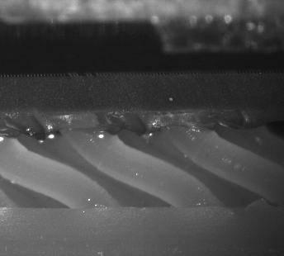
Hier III

Slide 6
Convergence Results

Slide 7
Videos – Hierarchy In Action

Slide 8
Videos – Squeegees in Action

Slide 9
Video/Camera/Microscope System
Not synched with force/position data
Illumination issues
Current hardware
Coaxial light
Ring light
Additional hardware?
More fiber optic sources
UV illumination
filter

Slide 10
Nano-indenting & selective Particle adhesion
Paul Day in collaboration with Los Alamos National Laborartory

Slide 11
Nano-Indenting
Concept
Make mold in soft wax by indenting with a sharp object (utility blades, razor blades)
Benefits
multi-angle cavities
High aspect ratios
Scalable pattern size with wax block size and workspace of indenter
No litho processes
Tip radii are about 1-4um

Slide 12
Nano-Indenting Results
180um
11um
80um

Slide 13
Nano-Indenting Results

Slide 14
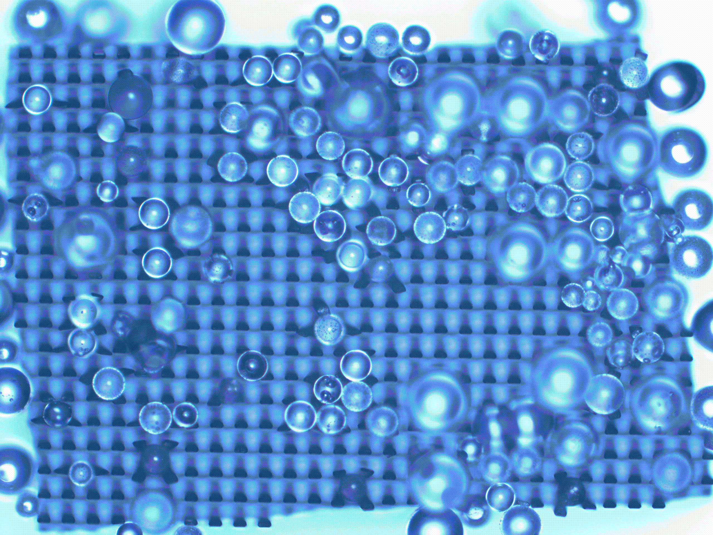
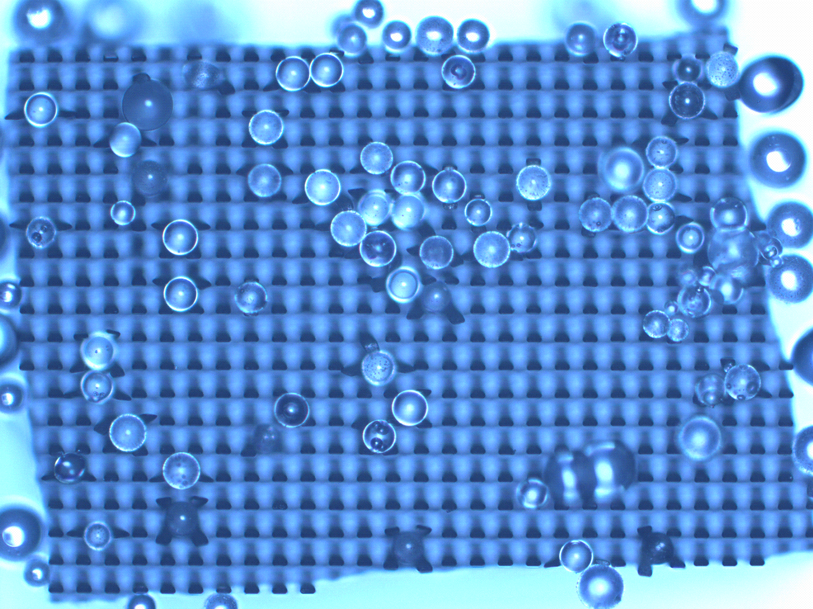
Selective Particle Adhesion
Concept
Use a micro-structured adhesive to select(filter) a certain size range of particles
Before
After

Slide 15
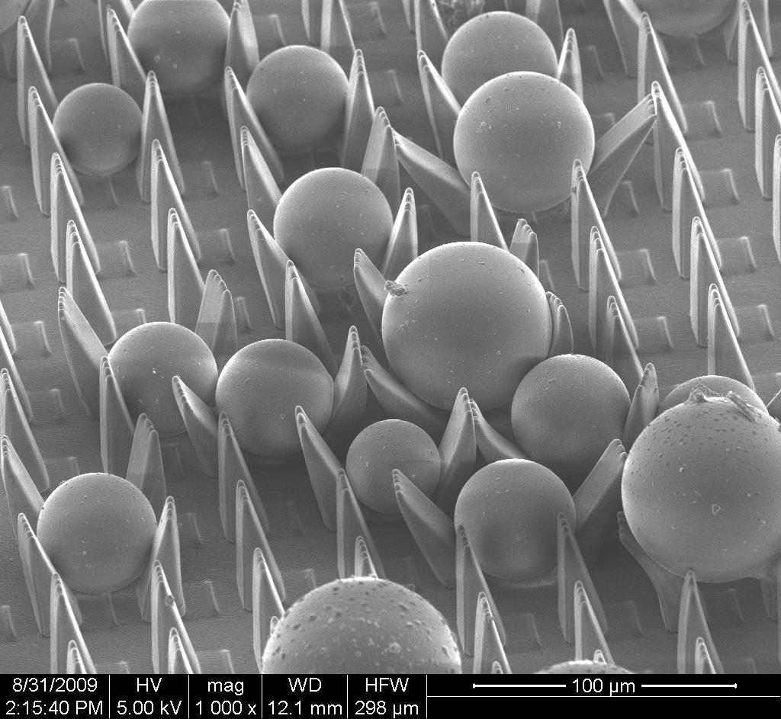
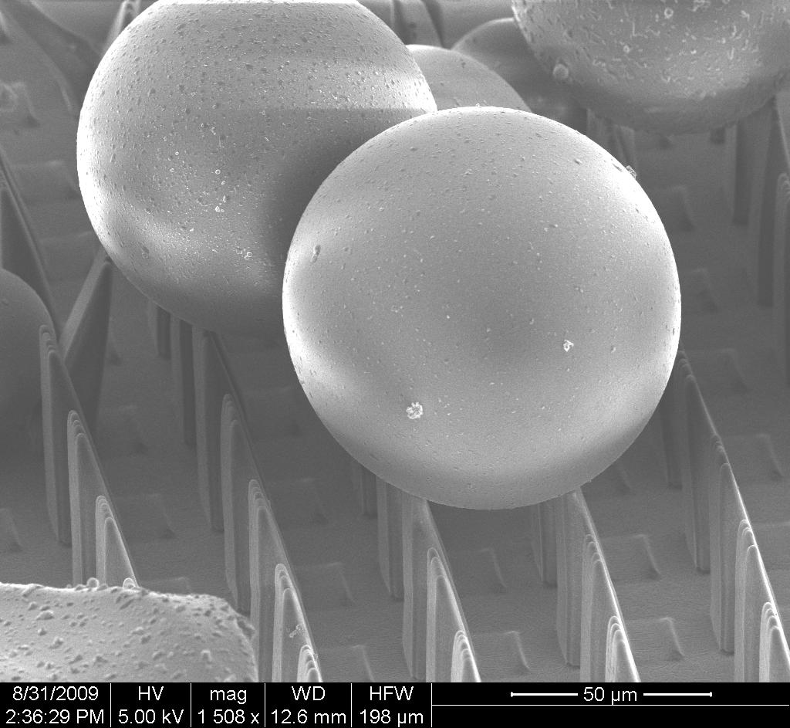
Interesting Particle Wedge Interaction

Slide 16
Interesting Particle Wedge Interaction

Slide 17
More Particles and Wedges

