Slide 1
Rock Climber Mechanics Research Summary

Slide 2
Background
The mechanics of rock climbing is not frequently a topic of journal articles
Most articles on climbing focus on the physiology of rock climbers and injuries caused by rock climbing.
Articles on the physiology of climbers include (these articles are not covered in the following slides) :
[6]
Schweizer, S. "Biomechanical properties of the crimp grip position in rock climbers ." Journal of Biomechanics 34 (2001): 217-223.
[8]
Watts, P. "Physiology of Difficult Rock Climbing." European Journal of Applied Physiology 91 (2004): 361-372.
Few discuss the mechanics of climbing and focus on the static forces in equilibrium
None (that I found) analyze the forces required to move the body upward

Slide 3
Documents
Read 6 articles which are relevant and discuss the mechanics of rock climbing
[1]
Quaine, F, J. P. Blanchi, and L. Martin. "The Effect of Body Position and Number of Supports on Wall Reaction Forces in Rock Climbing." Journal of Applied Biomechanics 13 (1997): 14-23.
[2]
Quaine, F, J. P. Blanchi, and L. Martin. "Effect of a Leg Movement on the Organisation of the Forces At the Holds in a Climbing Position 3-D Kinetic Analysis." Human Movement Science 16 (1997): 337-346.
[3]
Bourdin, C., N. Teasdale, V. Nougier, C. Bard, and M. Fleury. "Postural Constraints Modify the Organization of Grasping Movements." Human Movement Science 18 (1999): 87-102.
[4]
Testa, M., L. Martin, and B. Debu. "Effects of the Type of Holds and Movement Amplitude on Postural Control Associated with a Climbing Task." Gait and Posture 9 (1999): 57-64.
[5]
Quaine, F., and L. Martin. "A Biomechanical Study of Equilibrium in Sport Rock Climbing." Gait and Posture 10 (1999): 233-239.
[7]
Noe, F., F. Quaine, and L. Martin. "Influence of Steep Gradient Supporting Walls in Rock Climbing: Biomechanical Analysis." Gait and Posture 13 (2001): 86-94.

Slide 4
Documents (cont.)
The earliest, Article [1] is from 1997 and is the first to cover the forces on holds in rock climbing:
4 hold stance
3 hold (right hand released) stance
effect of trunk distance from supporting wall on forces
Article [2] came from the same experimental setup (equipment and subjects) as [1] and analyzes the transition between 4 and 3 hold stances and the position of the center of gravity:
4 hold stance
3 hold (right foot released) stance
calculate impulse
discussion of location center of gravity

Slide 5
Documents (cont.)
Article [3] is less relevant and discusses the effect of posture and hand hold size on the speed that a climber grabs an upper limb hold, (this article is not discussed in the following slides)
grasping and reaching for holds
measurement of vertical forces and position only
vary posture by varying the starting hand hold size
Article [4] is similar to [1] and [2] in the way the experiment was performed and covered the calculation of momentum as well as impulse and forces
subjects were children climbers, “beginner level” (as opposed to [1] and [2] which covered adult climbers, “international level”)
4 hold stance
3 hold (right foot released) stance
center of gravity, forces, impulse, momentum

Slide 6
Documents (cont.)
Article [5] is also came from the same experimental setup (equipment and subjects) as [1] and [2], includes discussion of the reaction moments in addition to the forces in different stances
4 hold stance
3 hold (right foot released) stance
forces, moments around the left foot hold
Article [7] is similar to [5], it also explores the effect of have the supporting wall and holds at an overhanging angle, 10 degrees passed vertical
4 hold stance
3 hold (right foot released) stance
overhanging wall angle
forces, moments around the left foot hold

Slide 7
Methods

Slide 8
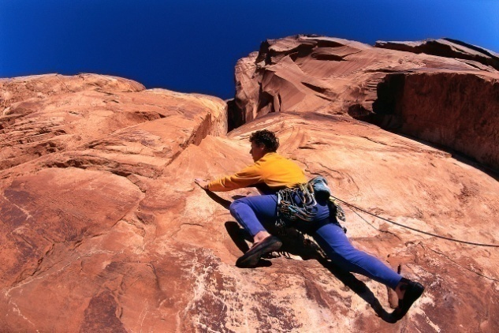
Subjects
[1, 2, 5]
6 adults,
‘international’ level
24.1 ± 1.9 years old
161.60 ± 11.24 lbs
5.74 ± .36 feet tall
[4]
5 children
beginner level
12.16 ± 1.08 years old
[7]
7 adults
‘international’ level
22 ±.4 years old
149.03 ± 8.38 lbs
5.73 ± .17 feet tall
*figure from Microsoft Clipart

Slide 9
Subjects (cont.)
Article | Subjects | Climbing Level | Age | Weight | Height
1 | 6 | international | 24.1 ± 1.9 years | 161.60 ± 11.24 lbs | 5.74 ± .36 feet
2 | 6 | international | 24.1 ± 1.9 years | 161.60 ± 11.24 lbs | 5.74 ± .36 feet
4 | 5 | beginner | 12.16 ± 1.08 years
5 | 6 | international | 24.1 ± 1.9 years | 161.60 ± 11.24 lbs | 5.74 ± .36 feet
7 | 7 | international | 22 ±.4 years | 149.03 ± 8.38 lbs | 5.73 ± .17 feet

Slide 10
Equipment
Articles [1,2,5] used the equipment shown right
This “artificial climbing frame” is described by
Rougier, P., R. Billat, M. Merlin, and J.P. Blanchi, “Elaboration of a device enabling the study of the posturo-kinetic coordination in a vertical plane: Application to climbers.*" Innovation et technologie en biologie et médecine. 12 (1991): 568-580.
*written in French, title translated to English to clarify topic
Contained 4 climbing holds each attached to a 3-D strain gauge
Used two camcorders (Y-Z plane, X-Z plane) to record limb and body position
*figure adapted from figure 1 in article [2]

Slide 11
Equipment (cont.)
The climbing holds in [1, 2, 5] were arrange in a rectangular pattern:
horizontally spaced to match the width of each subject’s shoulders
vertically spaced so that the subject “when standing on the experimental device, had his arms and thighs in a horizontal position,” [2]
This spacing forced the trunk of the body to be out far from the supporting wall (as shown in the imposed position), or closer to the wall with the limbs to be angled outward (as shown in the close optimized position)
The climbing holds in [4, 7] were arranged in a larger rectangular pattern:
horizontally spaced to twice as wide of the subject’s shoulders
vertically spaced to the subject’s height
This spacing allowed the trunk of the body to be closer to the supporting wall (as shown in the spread optimized position)
*figure adapted from [1] Figure 1 and [4] Figure 1

Slide 12
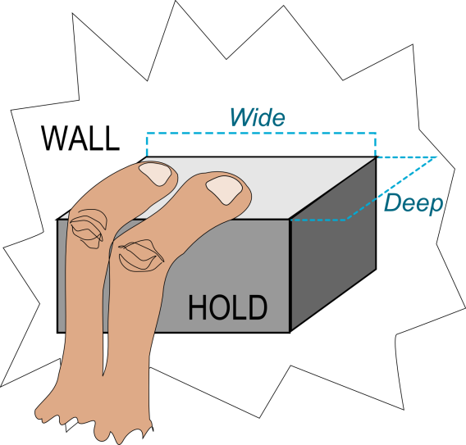
Equipment (cont.)
Climbing Holds
Shape and size of the hold affects the way climbers apply load
The equipment in the articles tended to use smaller, shallow ledges called “edge” holds
Edge style holds cause climbers to apply no torques to the holds
Hold depth was greater for the beginner level climbers, as shallower holds increase difficulty
Width and depth are the only important attributes of edge style holds
Article | Foot Hold |  | Hand Hold
 | Wide | Deep | Wide | Deep
1 | 1.5 cm | .7 cm | “slanting supporting surface”
2 | 1.5 cm | .7 cm | “slanting supporting surface”
4 | 10 cm | 2 cm (hard) 3 cm (easy) | 10 cm | 3 cm
5 | Holds Not Mentioned |  | Holds Not Mentioned
7 | 8 cm | 1 cm | 8 cm | 1 cm

Slide 13
Results

Slide 14
Results
Distribution of Forces [1,2,5] – arrangement of forces in imposed position with 4 or 3 holds
Proximity to Wall [1] – difference between arrangement of forces in an imposed stance and an optimized stance
Spread Stance [4,7] – 4-to-3 hold transition of a climber in the spread stance, a comparison to inexperienced climbers
Wall Incline [7] – the effect on the hold forces of an overhanging wall angle
Importance of Moments [5] – the role that moments play in determining the forces that maintain equilibrium

Slide 15
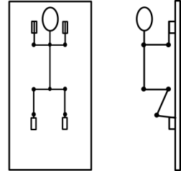
In the Graphs
Hand is Lifted
Hand is Lifted
Stable 4-Hold
Stable 3-Hold
Stable 4-Hold
Stable 3-Hold

Slide 16
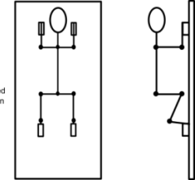
Distribution of Forces
~330N
~300N
~300N
Vertical
~60N
~60N
~70N
Lateral
~-60N
~-50N
~110N
~-90N
~150N
~80N
Normal (A.P.)
~-110N
~-80N
~-140N
RH Release [1]
RF Release [2]
RF Release [5]

Slide 17
From Distribution of Forces
In order to have smooth transitions from the 4 hold to 3 hold stances, the releasing limb is slowly unloaded prior to being lifted from the hold
In a 4 hold stance:
The upper holds are used primarily as stabilizers, providing contact (non-vertical) forces which control distance to wall and posture
The lower holds are used more for vertical forces to support the weight (*note the previous figure showed the vertical forces evenly distributed as was designated in the experiments in order to control initial conditions)
In the 3 hold stance:
The vertical forces are redistributed among the remaining holds, primarily transferring to the contralateral (opposite side) foot
The contact forces are all shifted to the contralateral side, unloading both holds on the side of the released hold, in order to prevent moments.

Slide 18
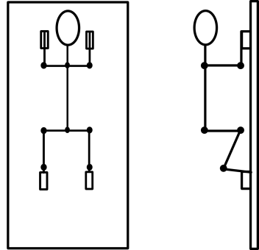
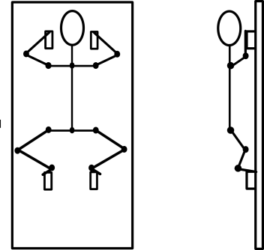
Proximity to Wall (RH Release)
~375N
~300N
Vertical
~60N
~50N
Lateral
~-80N
~90N
~120N
~100N
Normal (A.P.)
~-80N
~-130N
Imposed [1]
Optimized [1]

Slide 19
From Proximity to Wall
In the optimized position, each of the remaining three holds has an increased vertical force component to make up for a hold release
In the imposed position, only the contralateral holds gain vertical forces when a hold is released
The contact (non-vertical) forces are 1.4 times lower in the optimized positions than the imposed position.
This most apparent in the decrease of normal forces on the upper holds
The contact forces of the LH hold (in a RH release) are crucial (and similar between imposed and optimized positions) as it becomes the only hold preventing the climber from falling backwards
The optimized position is characterized by less severe transfers of body weight and lower contact forces due to increased use of the ipsilateral (same side) hold during 4-to-3 hold transitions, making it easier to maintain
All above topics discussed in [1]

Slide 20
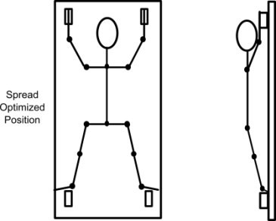
Spread Stance and Inexperienced Climbers [RF Release]
~375N
~300N
Vertical
~80N
~60N
Lateral
*
~-80N
~-90N
~60N
~130N
Normal (A.P.)
~-30N
~-150N
Beginners [4]
International Level [4]
* Suspect lateral signs are reversed

Slide 21
From Spread Stance and Inexperienced Climbers
The use of spread posture seems to indicate an increase in lateral forces over the imposed posture*
Beginners heavily favor using lower limbs (in 4-hold equilibrium) to:
Support vertical forces (~90% vs ~10% (on hand holds) of body weight)
Create lateral forces (9.7% vs 2.8% (on hand holds) of body weight)
The emphasis of the lower limbs in lateral force creation causes extreme shifts in forces during the 4-to-3 hold transition
Normal load applied by beginners is consistent with that applied by experienced climbers (~8% of body weight on all holds)*
It seems likely that the greatest forces encountered on lower holds would be caused by uneven loading from untrained users*
*This analysis comes solely from personal observations as such comparisons are not made between articles

Slide 22
Wall Incline [RF Release]
~325N
~325N
Vertical
~80N
~60N
Lateral
~-80N
~100N
~130N
~110N
Normal (A.P.)
~-70N
~-130N
Vertical [7]
Steep [7]

Slide 23
From Wall Incline
Overall, a vertical wall tended to favored the use of lower holds (57+12% of body weight), while a steep wall angle favored upper holds (62±9% of body weight)
Contact (non-vertical) forces were significantly lower in the steep position than when in the vertical position
In the steep position, the distribution of forces is more homogenous between the remaining holds than when in a vertical position
Theoretically (as suggested in [1]), this means that the steep position is mechanically easier to maintain than the vertical, however since “the legs are more adapted to support the body weight than the arms,” steep positions seem more difficult to climbers
All above topics discussed in [7]

Slide 24
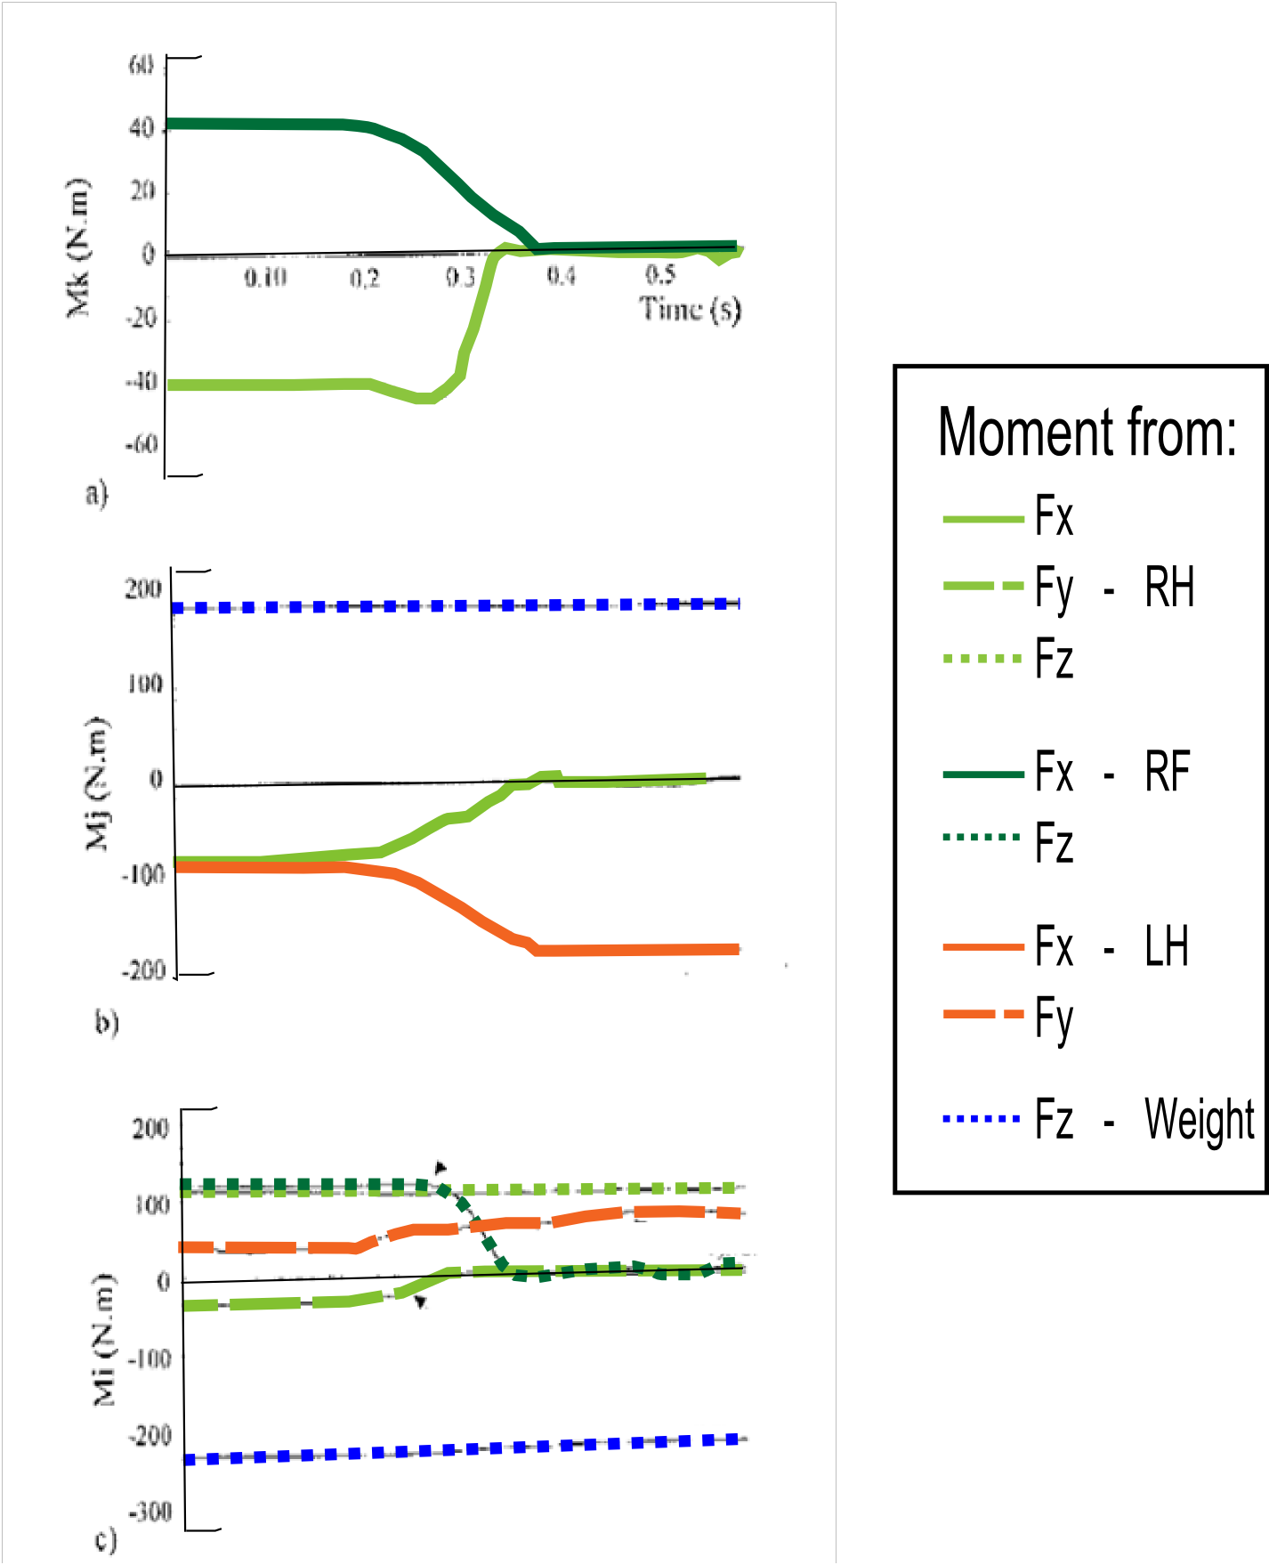
Importance of Moments (RF Release)
Vertical (Z)
Lateral
Lateral (Y)
Normal (X)
Imposed [5]

Slide 25
About Moments
The moment around each axis must be zero when the climber is in equilibrium
Because of this:
The removal of the RF normal force means that the RH normal force must also go to zero to prevent rotation around vertical axis
When RH normal force goes to zero, the LH normal force must increase to prevent rotation around the lateral axis as the moment from gravity remains constant
The removal of the RF vertical force causes the LH and RH to have increased lateral forces to prevent rotation about the normal axis as the moment from gravity remains constant.

Slide 26
Main Points
The upper holds, in most positions are used primarily for the purpose of stabilization of the climber (applying non-vertical forces), the lower holds are primarily used for applying vertical forces to support body weight
When transitioning to a three hold stance the majority of forces are transferred to the contralateral holds, often leaving the remaining hold on the releasing side bearing very few or no contact (non-vertical) forces

Slide 27
The Forces
Forces (in Newtons) |  | Imposed |  | Optimum |  | Spread
 | Direction | Maximum Avg. Forces | Releasing | Maximum Avg. Forces | Releasing | Maximum Avg. Forces | Releasing
Hand Hold
 | Vertical | 307±60 | Opp. Foot | 228±63 | Opp. Hand* | 288±32 | Opp. Foot – Steep Wall**
 | Lateral | -78±17 | Opp. Foot | Na
 | Normal | -214±24 | Opp. Foot | Na
Foot Hold
 | Vertical | 248±42 | Opp. Foot | 251±42 | Opp. Hand* | 331±73 | Opp. Foot – Vertical Wall**
 | Lateral | 68.5±15 | Opp. Foot | Na
 | Normal | 129±16 | Opp. Foot | Na
Data from: |  | [5] Weight = 73±5.1kg |  | [1] Weight = 73.3±5.1kg |  | [7] Weight = 67.6±3.8kg
*Only hand release data available
**Only foot release data available
Vertical: + indicates a downward force
Lateral: + indicates a force away from the centerline of the body
Normal: + indicates a force into the wall

Slide 28
The Forces
Forces (in pounds) |  | Imposed |  | Optimum |  | Spread
 | Direction | Maximum Avg. Forces | Releasing | Maximum Avg. Forces | Releasing | Maximum Avg. Forces | Releasing
Hand Hold
 | Vertical | 69±13 | Opp. Foot | 51±14 | Opp. Hand* | 64±7 | Opp. Foot – Steep Wall**
 | Lateral | -17±4 | Opp. Foot | Na
 | Normal | -48±5 | Opp. Foot | Na
Foot Hold
 | Vertical | 55±9 | Opp. Foot | 56±9 | Opp. Hand* | 74±16 | Opp. Foot – Vertical Wall**
 | Lateral | 15±3 | Opp. Foot | Na
 | Normal | 29±3 | Opp. Foot | Na
Data from: |  | [5] Weight = 161.60 ± 11.24 lbs |  | [1] Weight = 161.60 ± 11.24 lbs |  | [7] Weight = 149.03 ± 8.38 lbs
*Only hand release data available
**Only foot release data available
Vertical: + indicates a downward force
Lateral: + indicates a force away from the centerline of the body
Normal: + indicates a force into the wall

Slide 29
Calculations

Slide 30
Calculations
Information on forces and hold positions is collected experimentally [1]
Moments caused by holds are found from those forces and distances [5]
Initial Position of Center of Gravity (CoG) is calculated from those moments [5]
Impulse is calculated from the experimental forces [2]
Change in Position of the CoG is calculated from the impulse [2]
Actual Position of the CoG at any time is calculated from the initial position and the change in position of the CoG [5]
Moments during the experiment are found with the experimental forces, hold positions and the calculated position of the CoG [5]

Slide 31
Moments from Hold Reaction Forces
Moment Calculation
All moments are written as around the lower left hold
Sign of moments defined in figure shown right
Moments from hold forces (in quadrapedal equilibrium) are found from the experimentally collected forces and the distances between the holds as defined by the setup. The moments are then used to find the position of the center of gravity (in quadrapedal equilibrium):
The calculation is different for each force component and hold, but for example
is used to find the moment from the vertical force component about the left foot hold
*original graphic, Jennifer Cross
Fx, Fy, Fz = experimentally collected forces in the x, y, and z directions (respectively) W_{hold} = horizontal spacing between holds H_{hold} = vertical spacing between holds Mi, Mj, Mk = total moments on the climber’s body around the anteroposterior, lateral and vertical axis (respectively) through the lower left hold = moment caused by the right foot hold by the force component in the z direction around the lower left hold (similar abbreviations used for other hold reaction forces)

Slide 32
Initial Position of Center of Gravity
Initial Position of CoG Calculation from [5]
All moments are written as around the lower left hold
Calculated moments are used to find the initial coordinates of the center of gravity (when in quadrapedal equilibrium):
t_{quad} = time when the subject is In quadrapedal equilibrium (4-holds) Fx, Fy, Fz = experimentally collected forces in the x, y, and z directions (respectively) M_{Fx,} M_{Fy,} M_{Fz} = moments produced by Fx, Fy and Fz (respectively) around the lower left hold X_{CoG,} Y_{CoG} = anteroposterior and lateral positions (respectively) of the center of gravity W = weight of climber
*original graphic, Jennifer Cross

Slide 33
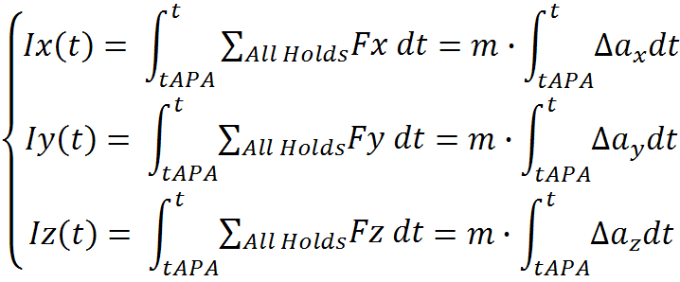
Impulse
Impulse on CoG Calculation from [2]
Impulse on the center of gravity is found from the experimentally recorded forces, the impulse is later used to calculate the changes in the center of gravity’s position
Integration of the experimental data is performed using Euler’s Numerical Method [2] (for example): ; h = 0.01 seconds [2]
*Note: In article [5], integration is performed using Newton’s Numerical Method - 2nd Order
m = mass tAPA = time of first force change ∆a_{x}, ∆a_{y}, ∆a_{z}= accelerations (in the x, y and z directions respectively) of the center of gravity
*equation from [5]

Slide 34
Position of Center of Gravity
Change in Position of CoG Calculation from [2]
The change in the center of gravity’s position during a given time can then be found from the calculated impulse. The change in position can then be used to find the actual position of the CoG at any given time
Position of CoG Calculation (adapted from [5])
The position of the center of gravity at a given time can then be found by combining the calculated initial position, and the change in position of the CoG. The position of the CoG can then be used to find the moment created by body weight
m = mass tAPA = time of first force change ∆a_{x}, ∆a_{y}, ∆a_{z}= accelerations (in the x, y and z directions respectively) of the center of gravity Ix, Iy = impulse on the center of gravity in the anteroposterior and lateral directions (respectively)

Slide 35
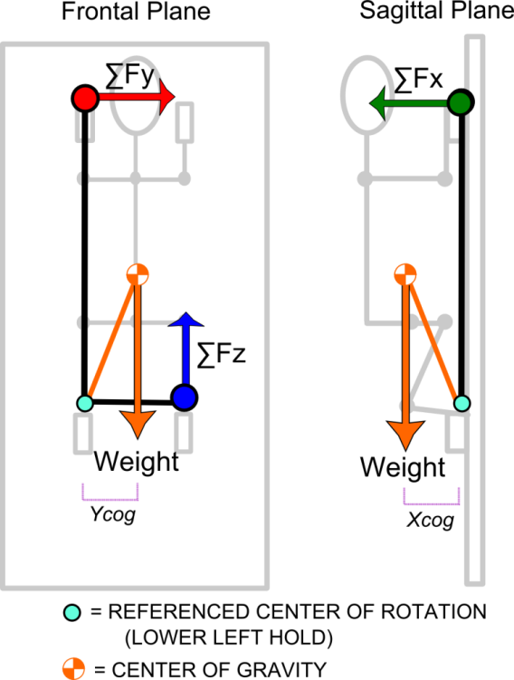
Moments
Moment from Body Weight
The moment from the climber’s body weight at any time can be found from the position of the center of gravity and the climber’s weight
The rotation of the climber can thus be defined by the following moment equations based on the experimentally collected force data:
M_{W}= moments produced by the climber’s body weight around the lower left hold R_{CoG} = position vector of the center of gravity W = weight of climber = moment caused by the right hand hold by the force component in the x direction around the lower left hold (similar abbreviations used for other hold reaction forces) Mi, Mj, Mk = total moments on the climber’s body around the anteroposterior, lateral and vertical axis (respectively) through the lower left hold

