Slide 1
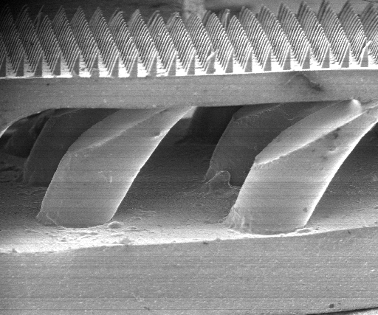
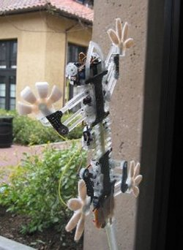
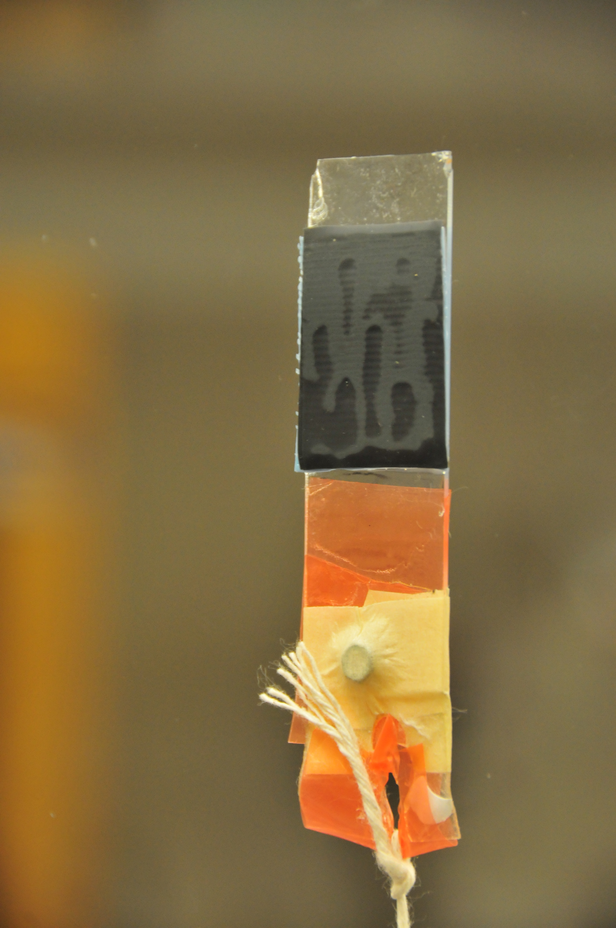
Microstructured Adhesives for Climbing Applications
Aaron Parness, PhD Candidate,
Mechanical Engineering, Class of 2009
Mark Cutkosky, ME Faculty

Slide 2
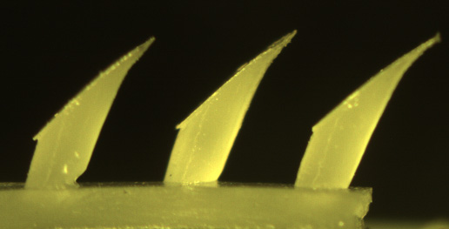
Sources of Inspiration
Russell, JAST, 2007
Autumn
Persson, J. Chem Phys, 2003
Kim et al, IEEE ICRA 2006
Yoon et al, JMEMS, 2003 & 2006

Slide 3
Wedge Fabrication Process Two Mask Dual Angle Exposure with Alignment

Slide 4
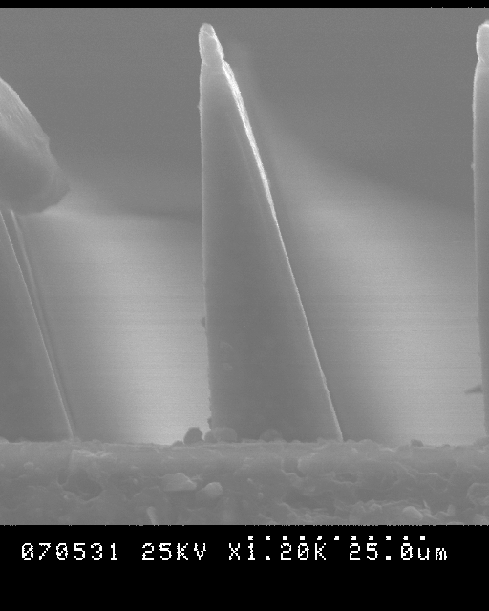
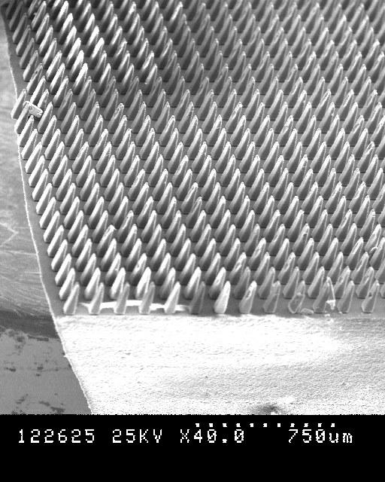
20 μm Wedge Arrays

Slide 5
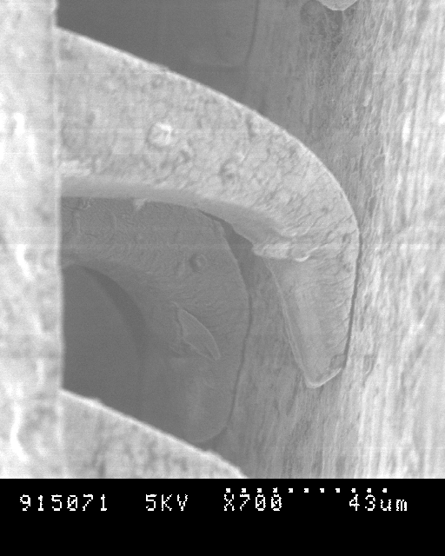
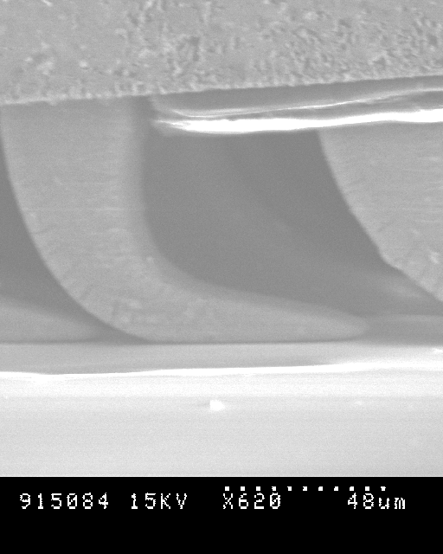
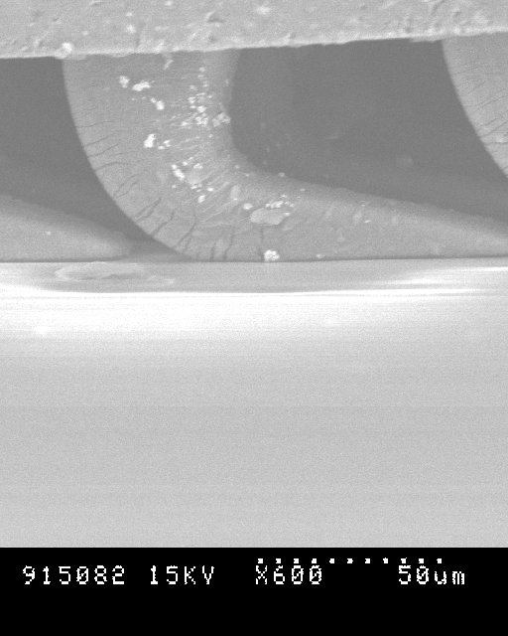
Loaded Wedges
Slightly Loaded
Moderately Loaded
Heavily Loaded

Slide 6
Limit Surface Shows Shear Dependence on Adhesion
Notes:
DIRECTIONALITY PLOT

Slide 7
Conforming to Surfaces
Challenges with Conformation
Alignment
Irregularities in backing layer
Surface roughness
Part tolerances of robot toes
patch size
patch size | θ
200μm | 5.7
1mm | 1.15
4cm | 0.029
20μm
θ
Smooth Surface
Notes:
Angular Calculations for sample wedge shape; pic of glass slide contact area; pic of SB toe contact area

Slide 8
Dynamic Adhesion
The ability to maintain adhesion while failing in shear.
Microstructured adhesive
Gecko setal array

Slide 9
Gecko Hierarchical Adhesive Structures
Hierarchy should improve conformation to the surface while maintaining proper load distribution facilitating better performance on semi-rough surfaces and scaling to larger patch sizes.

Slide 10
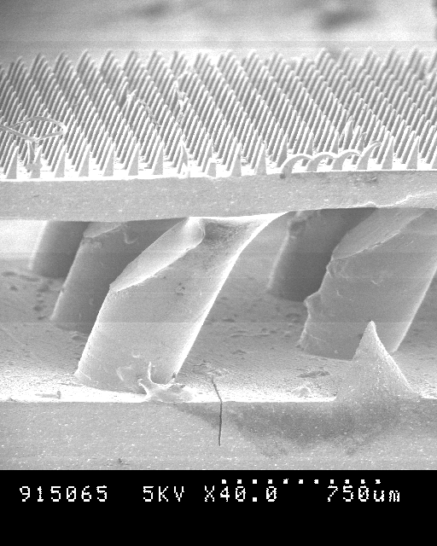
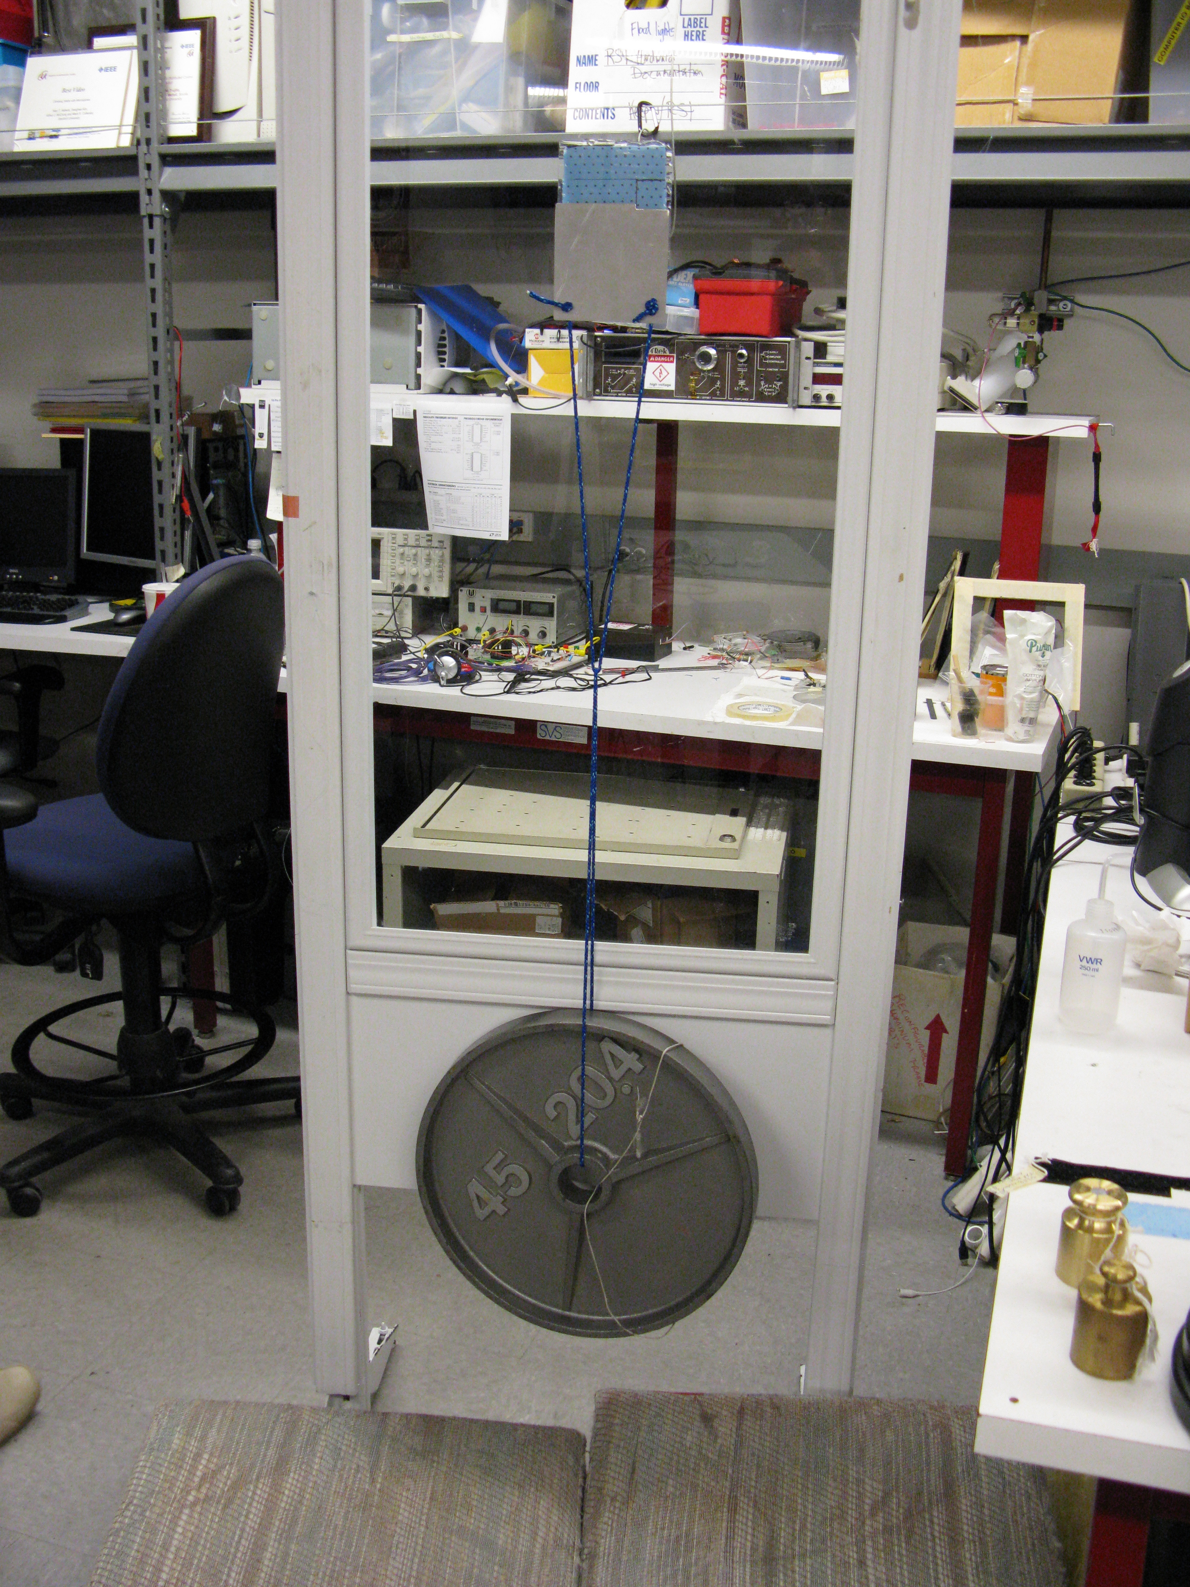
Synthetic Hierarchical Adhesive Structures Improve Performance on Roug Surfaces and Large Patch Alignment
Bi-layer design allows compliance on millimeter and micrometer scales
4 by 4 inch patch holds 45 lbs!

Slide 11
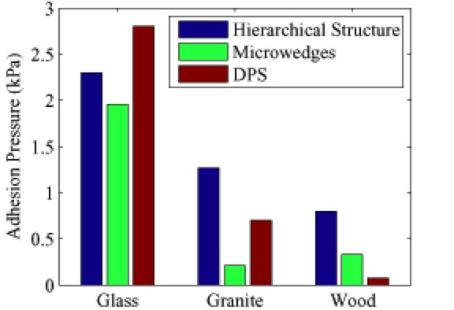
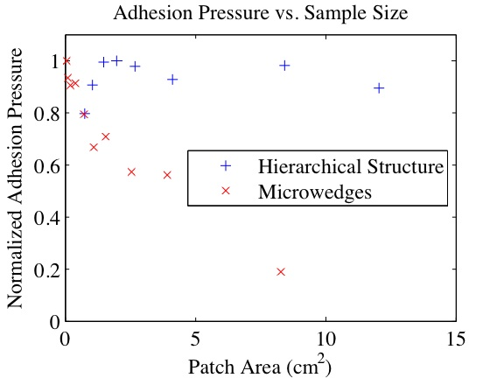
Hierarchy Data
As predicted, improved performance on semi-rough surfaces,
and in scaling to larger sample sizes.

